Slide 1
EVALUATION OF THE IMPLEMENTATION OF THE SMART CITY CONCEPT IN VISEGRAD GROUP COUNTRIES
14th International Evaluation Conference
MaY 2021

Slide 2
Speakers
Michał Wolański, PhD, Project Manager
Wolański sp. z o.o., Warsaw School of Economics
Anna Borowczak, PhD
EGO S.C., UAM Poznań
deals with public affairs and socio-economic development, including the impact of EU policies
Paulina Kozłowska
Wolański sp. z o.o.
specialized in sustainable urban mobility, economics of transport, rail transport, rural transport, as well as evaluation and EU funds
analyst and project manager, expert in quantitative and qualitative methods

Slide 3
agenda
1. SCOPE OF THE STUDY
2. SMART CITY PROJECTS IN V4 COUNTRIES
4. CONCLUSIONS AND RECOMMENDATIONS
3. SMART CITY AND COVID-19

Slide 4
SCOPE OF THE STUDY

Slide 5
What is smart city?
Urban environment in which a digital approach to sustainable development has been introduced to reduce resource consumption, improve quality of life and enhance economic competitiveness
Being a Smart City requires not only direct implementation of digital (ICT) solutions, but also changes in the way the city is managed
The concept of Smart City should be understood not only as a set of technological solutions, but as a response to the negative impact and challenges of the urbanization process, as well as support in response to unforeseen events, e.g. a pandemic

Slide 6
3 Main research questions
Q1
Q2
Q3
What factors and mechanisms increase the success of Smart City projects?
What are the good practices of Smart City projects in V4 countries?
How the concept of Smart Cities has been implemented in key strategic, programming documents in V4 countries?

Slide 7
Analytical framework
Includes criteria of influence and utility
PURPOSE of the public policy actions
Specific urban challenge and needs of specific users
Inclusion and sustainability criteria of evaluation
PROCESS of the project
Stakeholders’ involvement
Innovative technology
Efficiency and effectiveness criteria of evaluation
MEANS of public policy

Slide 8
methodology
Interviews with representatives of ministries in the V4 countries
Comparative synthesis
Q2 i Q3: Smart City good practices and success mechanisms
165 good practice proposals from national experts
Selection of 56 projects covering the matrix
Document review at national and local level
Q1: Implementation of the Smart City concept in V4 documents
Qualitative comparative analysis (QCA)
Interviews, documentation analysis and nethnographic research

Slide 9
SMART CITY PROJECTS
IN V4 COUNTRIES

Slide 10
Pool of smart city projects
165 collected:
64 Polish
40 Hungarian
36 Slovak
25 Czech
56 chosen:
27 Polish
11 Hungarian
9 Slovak
9 Czech

Slide 11
Research areas
City management
Energy
Business and entrepreneurship
Environmental protection
Healthcare
Transport
Science and education
Tourism
Culture and activation of inhabitants
Waste, water and sewage management

Slide 12
Highlights of the projects
Solutions based on detectors and data collection in real time, as well as mobile applications, dominate
More than half of the projects would be applicable in any urban area, regardless of size, and some only in areas of a certain size (e.g. automatic metro)
Only 19 out of 56 projects were supported from public funds
and 13 solutions were co-financed from EU funds
In 15 projects, attention was paid to the interoperability of solutions, allowing for their functional expansion
2 features of projects in the context of Covid-19: resistance to the effects of a pandemic or support for the fight against it

Slide 13
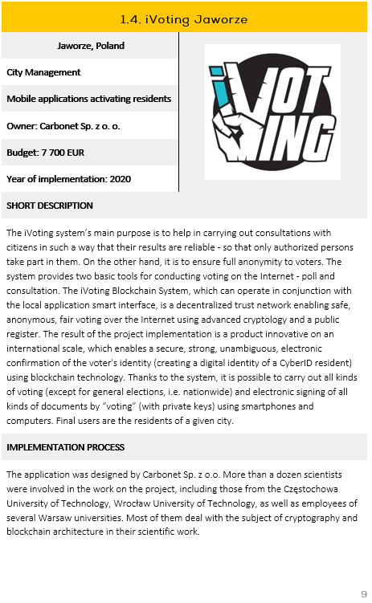
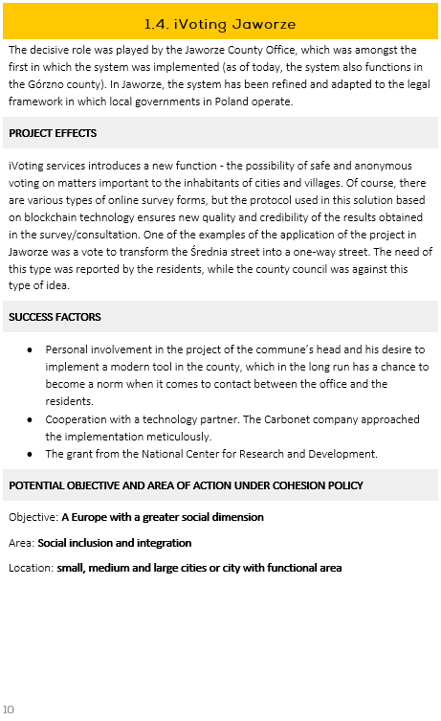
Catalogue of smart city good practices

Slide 14
Smart city and covid-19

Slide 15
Projects immune to effects of a pandemic
Limiting interpersonal interactions
E-control SPPN Warsaw – limiting the number of pedestrian controllers' patrols in the area
Using non-contact technologies
Librus – e-register, supports remote learning during a pandemic
InPost Chatbot – supports information about courier deliveries at a time when access to traditional points of sale was limited
Smart Heat Distribution Network Warsaw – remote diagnostics of network status
iVoting Jaworze – the possibility of conducting remote voting on public matters

Slide 16
projects supporting the fight against the pandemic
Telemedicine
Public safety
Areas where access to public services has been limited (e.g. education, administration)
Smart City Poznan – mobile application (e-alerts)
ProteGo Safe (Poland)
Záchranka – mobile application (Czech Republic)
Monse – health monitoring of seniors living alone at home (Slovakia)
National e-Health infrastructure (Hungary)
Visual detection of crowds in Gdynia
Golemio Prague (Czech Republic) – joint digital data administration of various city departments
Mozaweb (Hungary) – digital school app

Slide 17
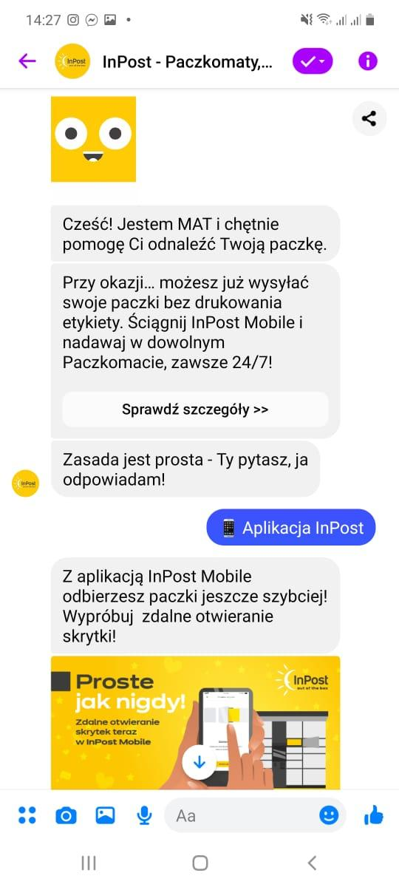
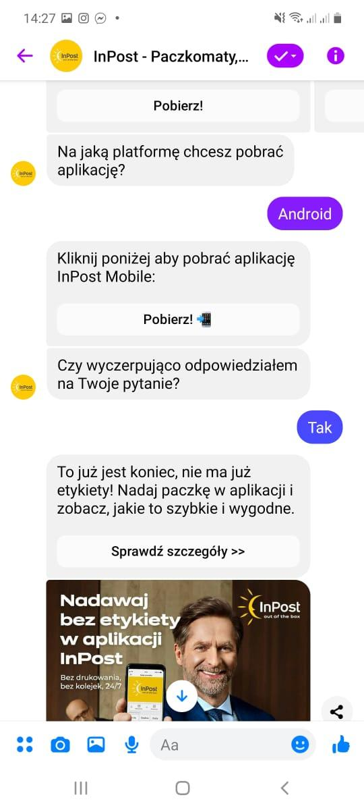
InPost Chatbot (Poland)
If the customer's question is not answered - messages sent to the customer service department
Answer to the most frequently asked questions from connections to the hotline
Solution of a private company, but related to the field of city logistics
Possibility to check the delivery status, location and data
Willingness to speed up customer service, and during the pandemic, customer demand exceeded the supply of parcel lockers
Chatbot available via Messenger, WhatsApp and Google Assistant

Slide 18
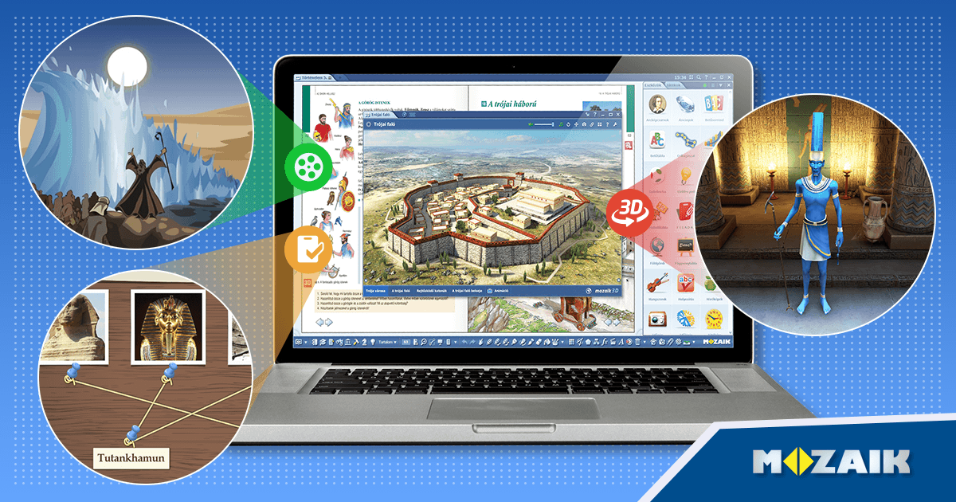
Mozaweb (hungary)
Toolkit for a complex educational program
Facilitates communication between the student and the teacher, generating content and providing interactive tools
All-in-one solution, all subjects and topics covered in the classroom
Solution consists of: databases and sources of knowledge, digital board, interactive e-school, digital register
During a pandemic, it enables remote education

Slide 19
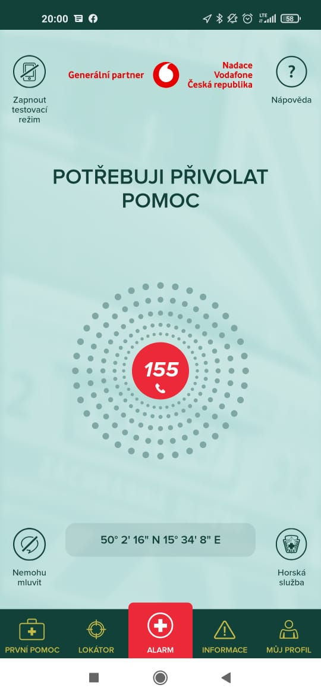
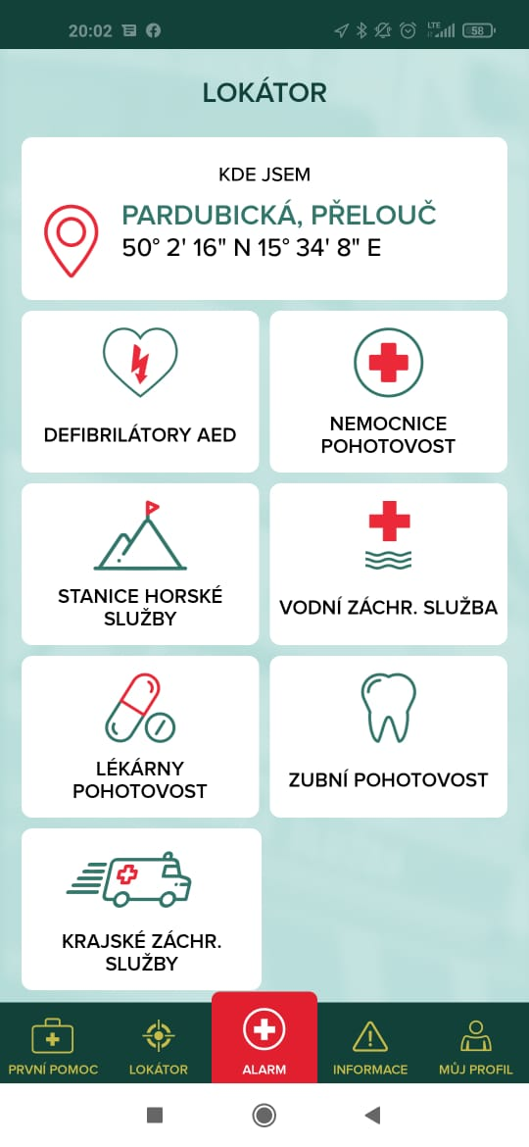
Záchranka (Czech republic)
During a pandemic - support for health protection through faster and more accurate transmission of information about events
System is connected with 14 regional dispatch centers as well as water and mountain rescue services
Project was developed as a non-profit based on funds from foundations and grants
Application supporting making emergency calls
Possibility of making a video call and immediate transmission of location data and battery level

Slide 20
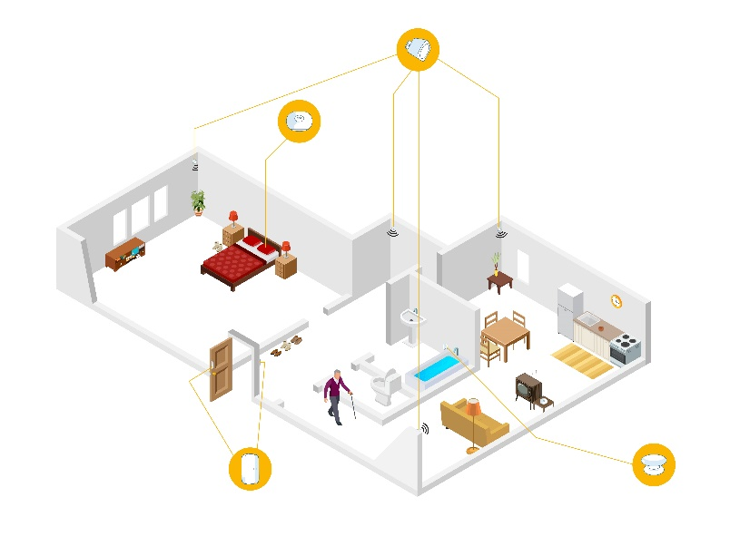
Monse (slovakia)
During a pandemic - remote monitoring of the elderly, especially important when it was recommended not to leave homes
In the event of an alarm, the information is provided to the person caring for the senior, along with telephone communication
The system takes into account technological limitations related to age - problems with motor skills or forgetting to regularly charge devices
Remote monitoring of the health of seniors living alone at home
Installation of sensors at home, monitoring the activity of an elderly person and an SOS button

Slide 21
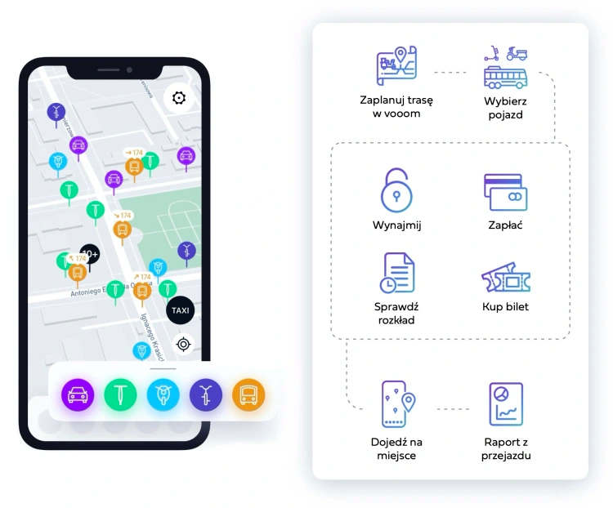
Vooom – the only project negatively influenced by covid-19
Significant decrease in demand for urban mobility during the pandemic - remote work
Redirecting development into a multimodal travel planner
Signed letters of intent to develop the solution with Gdynia City Hall and GZM Metropolis
Mobility budget offered to employees
One app with a customer account for using public transport, shared vehicles and taxis
Plan a trip
in Vooom
Select
vehicle
Rent
Pay
Check
schedule
Buy ticket
Get to
the point
Trip report

Slide 22
Conclusions and recommendations

Slide 23
Key Findings in the context of covid-19
Smart City resistant to the effects of a pandemic
Smart City supporting the fight against the pandemic
The pandemic generally does not affect the operation of solutions, and their effects are also achieved during remote work
The most important area of supporting solutions is Healthcare - provided by telemedicine services
In the field of public safety, the solutions support e.g. detection of crowds or potential contact with an infected person
By using digital services, residents quickly adapt to the frequently changing reality and limitations
Solutions providing remote services that minimize interpersonal contacts stand out
It was also important to ensure access to services in which contacts were significantly limited - in education and administration

Slide 24
Research conclusions
Peculiarity of Smart City projects
Strategic level invisible to owners and contractors
Lack of holistic suport of Smart City initiatives
Legal regulations are barriers
Smart City immune to the effects and supporting the fight against the pandemic
Technology like lego bricks
Types of projects: scouts vs main force
Some configurations lead to ecosystem
Lack of uniform definition
Sound but not cutting-edge innovative technology

Slide 25
Recommendations for strategic planning
Comprehensive support, not only for investments, but also through the development of competences in cities: trainings, study visits, pilot projects and co-financing teams
More forms of financing: investment funds, accelerators or incubators; as well as the possibility of conducting pilots and implementing projects by partnership of cities
Equalizing the distribution of funds between metropolises and small and medium-sized cities
Metropolises - creating new, innovative solutions
Small and medium-sized cities - implementation of effective solutions
Necessary legal flexibility - in the context of implementing new solutions
Comparative study with Smart City leaders in the world should be performed - how to create an ecosystem of support by central administration - in terms of regulation, organization and financing

Slide 26
Thank you for your attention

