Slide 1
Analysis of ESIF Measures Responding to COVID-19 Coronavirus Pandemic
Work in progress
Commissioned by the Ministry of Regional Development of the Czech Republic

Slide 2
Objective of the evaluation
Assess the support provided for elimination of impacts of COVID-19 pandemic by:
Analyzing the relevance and effectiveness of ESIF supported measures to pandemic in order to provide inputs for future targeting
Analyzing the specifics of reaction of selected member states to COVID-19 within ESIF
Rigorously analyze the impacts / effects of ESIF-supported measures reacting to COVID-19 pandemics

Slide 3
Understanding of the objectives
Map all anti-pandemic measures that have been implemented, analyze whether support was well targeted (to sectors and areas which were severely struck by the pandemic) and analyze whether the potential of ESIF was well taken advantage of (incl. CRII/CRII+ and ReactEU);
Aggregate good practice from other member states with regard to using ESIF for anti-pandemic measures (as inspiration for future reference);
Analyze impacts of selected anti-pandemic measures by application of CIE (what worked and what did not work and why?)

Slide 4
Tasks / activities
The following activities are to be implemented in order to deliver:
Map, study and analyze all anti-Covid programmes (desk research)
Create a typology of economic sectors (NACE 2nd level) with regard to how severly they were impacted by the pandemic (desk research, statistical analysis)
Overlap results of 1. and 2. in order to assess how well the support was targeted
Aggregate good practice of selected EU member states (desk research, survey, interviews)
Implement counterfactual design (supported vs. non-supported companies, applying PSM matching and DiD) especially with regard to:
Survival rate
Sustaining of employment (FTE)

Slide 5
Current status quo – work in progress
Project launched in January, first deliverables in June – objectives 1 and 2
Key milestone: availability of 2020 economic data of enterprises – key inputs for CIE, expected ca. July
First draft CIE analysis – September 2021
Final report – January 2022

Slide 6
1. Map, study and analyze (…)
Created analysis matrix, structured information on programmes in force since March 2020, including:
Targeting of the programme (NACE or other criteria)
Regional scope
Financial scope
Type of support (direct financial support, financial instruments, etc.)
Support of ESIF, if any
Timeframe of the programme
Target groups
Etc.

Slide 7
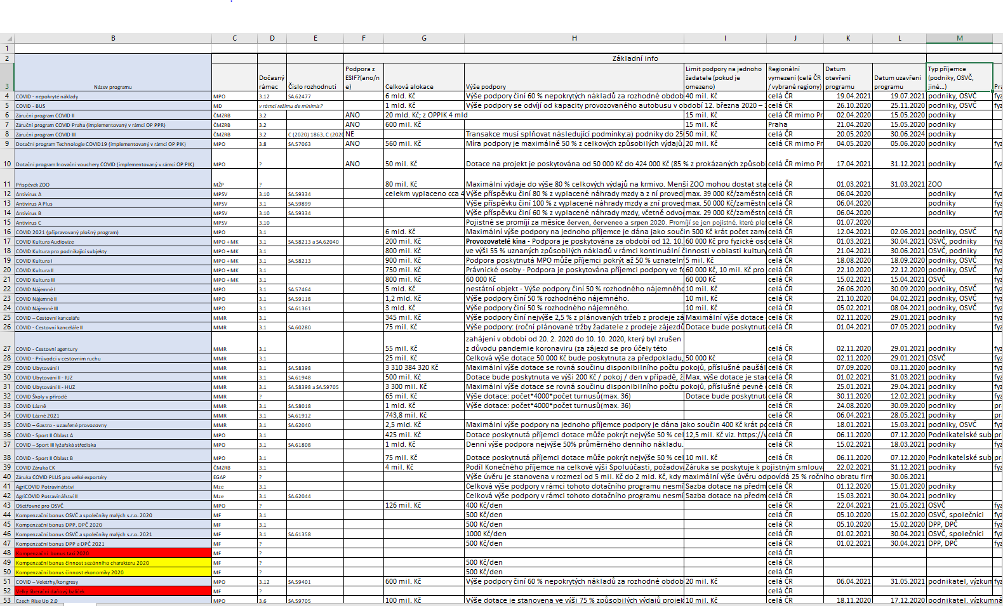

Slide 8
1. Map, study and analyze (…)
Basic data:
Overall financial scope: over 3,5 bil. EUR direct support (out of that almost ca. half spent of “kurzarbeit”-type of support), ca. 25 mil. on loans and ca. 6,5 – 7 bil. EUR allocated to guarantee schemes
ESIF support:
Ca. 160 mil. direct support – “kurzarbeit” schemes – sustain workplaces (ca. 10 %)
Ca. 23 mil. direct grant support within OP Entrepreneurship for Competitiveness (investment into technologies, support to innovations, etc.)
Ca. 180 mil. in guarantees (less than 5 % of total scope)
Clear trend from sectoral ad-hoc (and often complicated in calculation of support) programmes to a more general support – eligibility by trend of sales and support calculated on the bases of FTEs or uncovered costs

Slide 9
2. Typology of COVID-impact
Methodology:
Typology based on the quarterly / yearly trends of profits (profit rate – gross surplus over gross value added) and turnover/sales:
Typology based on three sources: aggregate sectoral data, sample micro-data and expert estimates
 | Businesses with low profits | Businesses with average profits | Businesses with high profits
Businesses with significant turnover decline | Most endangered companies | Endangered companies | Businesses able to finance outage in sales
Businesses with potential turnover decline | Endangered companies | Endangered companies | Businesses able to finance outage in sales
Businesses with no turnover decline | Minor influence of demand crisis | Minor influence of demand crisis | Least endangered companies

Slide 10
2. Typology of COVID-impact
Current status quo:
Available quarterly data on turnover / sales / production trends, NACE 2
Quarterly data on profit rate available only on too high level of aggregation – not applicable in our research
-> we will wait for yearly data for 2020 to complete the analysis (yearly trend of profit rate is sufficient for the analysis)
Therefore: partial application of methodology – identification of vulnerable and stable sectors on the basis of performance trends (turnover/sales; production in the case of construction sector)
(Eurostat: sts_crop_q, sts_setu_q, sts_intv_q, sts_trtu_q)

Slide 11
2. Typology of COVID impact
Moderate negative impact:
47 (Retail trade)
82 (Office administrative and support)
45 (Sales and repair of motor vehicles)
49 (Land transport)
41 (Construction of buildings)
81 (Services to buildings and landscape activities)
Generally:
Sections H – N (services)
Section M (professional, scientific and technical activities)
Section C (Manufacturing)
Little to zero impact:
68 (Real estate activities)
69 (Legal and accounting services)
47.11, 47.2 (retail sale of food and beverages)
62 (Computer programming, consultancy,…)
58 (Publishing activities)
Generally:
- Section J: ICT
Strong negative impact NACE:
79 (Travel agency, etc.)
51 (Air transport)
55 (Accommodation)
56 (Food and beverage service)
50 (Water transport)
96.02-09 + 93.13 (Hairdressing, physical well-being, fitness, funeral)
Rest of 96 (other personal services)
Strong positive impact:
63 (Information services activities)
53 (Postal and currier activities)
47.9 (Retail sale not in stores) – index 54,8
47.91 (Retail sale via mail order houses or internet) – 72,4
Moderate positive impact:
47.4 (Retail sale of ICT)
47.73-74 (Retali sale of chemist and medical goods)
42 (Civil engineering)
61 (Telecommunications)
decrease in performance
increase in performance

Slide 12
4. Good practice of other MS – in progress

Slide 13
THANK YOU!
Lukas Malac email: malac@eace.cz

